Slide 1
Cost prediction of health insurance
Predicting the cost of insurance

Slide 2
Basic structure of project
Collecting the data
Studying about the data
EDA
Working on categorical data
Splitting the data into train and test sets
Pipeline
Creating an model
Evaluation using cross-validation
Prediction on the test set
Evaluating
Fine tuning the model to get good accuracy
Deploy

Slide 3
Getting the data
 | age | sex | bmi | children | smoker | region | charges
0 | 19 | female | 27.900 | 0 | yes | southwest | 16884.92400
1 | 18 | male | 33.770 | 1 | no | southeast | 1725.55230
2 | 28 | male | 33.000 | 3 | no | southeast | 4449.46200
3 | 33 | male | 22.705 | 0 | no | northwest | 21984.47061
4 | 32 | male | 28.880 | 0 | no | northwest | 3866.85520

Slide 4
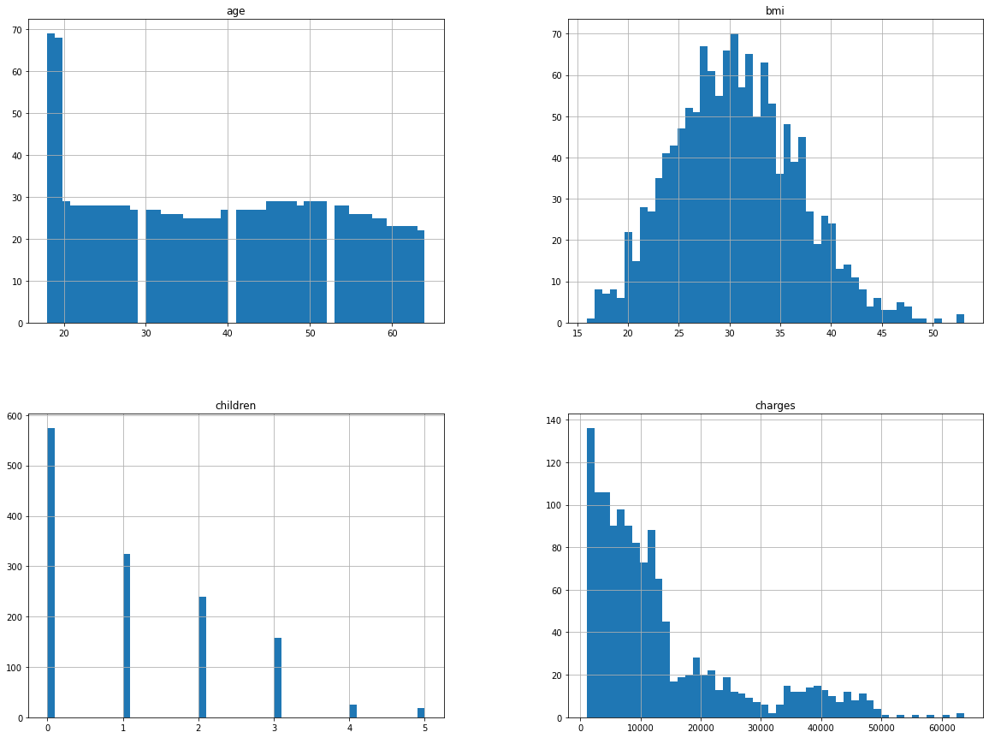
EDA
Getting an complete analysis of the each feature in the data.

Slide 5
Feature engineering
Checking the categorical data(after converting the obj to int)
Checking the null values(there is no null values in the data set)
 | age | sex | bmi | children | smoker | region | charges
0 | 19 | 0 | 27.900 | 0 | 1 | 1 | 16884.92400
1 | 18 | 1 | 33.770 | 1 | 0 | 2 | 1725.55230
2 | 28 | 1 | 33.000 | 3 | 0 | 2 | 4449.46200
3 | 33 | 1 | 22.705 | 0 | 0 | 3 | 21984.47061
4 | 32 | 1 | 28.880 | 0 | 0 | 3 | 3866.85520
age 0
sex 0
bmi 0
children 0
smoker 0
region 0
charges 0
dtype: int64

Slide 6
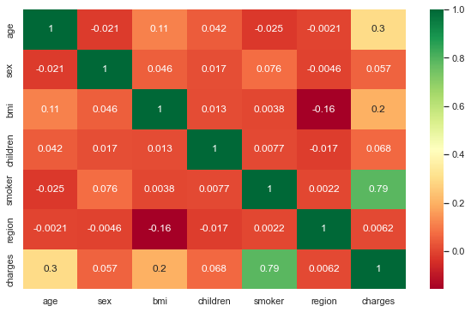
Correlation Diagram

Slide 7
Splitting up the data into x,y variables
1338 rows × 6 columns
X_variable
Y_variable(target variable)
 | age | sex | bmi | children | smoker | region
0 | 19 | 0 | 27.900 | 0 | 1 | 1
1 | 18 | 1 | 33.770 | 1 | 0 | 2
2 | 28 | 1 | 33.000 | 3 | 0 | 2
3 | 33 | 1 | 22.705 | 0 | 0 | 3
4 | 32 | 1 | 28.880 | 0 | 0 | 3
... | ... | ... | ... | ... | ... | ...
1333 | 50 | 1 | 30.970 | 3 | 0 | 3
1334 | 18 | 0 | 31.920 | 0 | 0 | 4
1335 | 18 | 0 | 36.850 | 0 | 0 | 2
1336 | 21 | 0 | 25.800 | 0 | 0 | 1
1337 | 61 | 0 | 29.070 | 0 | 1 | 3
0 16884.92400
1 1725.55230
2 4449.46200
3 21984.47061
4 3866.85520
... 1333
10600.54830 1334
2205.98080 1335
1629.83350 1336
2007.94500 1337
29141.36030
Name: charges, Length: 1338, dtype: float64

Slide 8
Splitting the train and test
After getting the x,y variable we need to split them into train&test for both x,y variables

Slide 9
Creating an model and predict that into test sets.
This is an regression problem so we need to create models like linear regression, random forest regression, decision tree regressor, svr

Slide 10
Creating an pipe line to know the best model that suits for our data set
linear regression test accuracy 0.7901579332949634
Random Forest Regressor test accuracy 0.8456368923315002
SVR test accuracy -0.08724655900831246
decision tree regressor test accuracy 0.741737157110795

Slide 11
Checking RMSE,MSE,MAE for our models
Linear regression
Random forest regressor
mean absolute error: 3769.8979504168346
mean squared error: 29708045.030370474
root mean squared error: 61.39949470815566
mean absolute error: 2207.347129857199
mean squared error: 16445686.515982471
root mean squared error: 46.982412984617966

Slide 12
Evaluating the model by using the r2score
r2_score for lr 0.7901579332949633
r2_score for rf 0.8438362859835116

Slide 13
Evaluation using the cross-validation(grid_search_cv)
Scores: [4677.60448369 5795.21225411 5751.58190774 5161.96492073 5224.25018351
4676.13338594 4761.12084891 5872.60179722 5002.81051256 4487.77319699]
Mean: 5141.10534914008
Standard deviation: 486.2469817492904

Slide 14
Fine-tuning the model to get an good accuracy
GridSearchCV(cv=5, estimator=RandomForestRegressor(),
param_grid=[{'max_features': [2, 4, 6, 8],
'n_estimators': [3, 10, 30]}, {'bootstrap': [False],
'max_features': [2, 3, 4], 'n_estimators': [3, 10]}],
return_train_score=True,
scoring='neg_mean_squared_error')

Slide 15



Deploy
Deploying the machine
Learning model by using
The flask.
Pred
i
ct Insurance Cost
age
age
sex
sex
bmi
bmi
children
children
smoker
smoker
region
region
Predict
Insurance Cost should be $ 16922.63

